Slide 1
JAVA COMMENTS, LITERALS, KEYWORDS, VARIABLES AND DATA TYPES
-SAYALI YADAV

Slide 2
JAVA COMMENTS
Java comments are annotations that developers include in the code to make it more readable and understandable. They are ignored by the compiler and are purely for human readers. There are two main types of comments in Java:
Single-line comments( // )
Used for brief explanations or notes on a single line of code.
Multi-line comments( /* */)
Useful for longer descriptions or explanations that span multiple lines.
int a=10 ; //this is variable
/*
*This is a multi-line comment * It spans multiple lines
* Used for longer explanations
*/

Slide 3
Javadoc comments
Documentation comments are usually used to write large programs for a project or software application as it helps to create documentation API. These APIs are needed for reference, i.e., which classes, methods, arguments, etc., are used in the code.
Syntax:
/**
*
*We can use various tags to depict the parameter
*or heading or author name
*We can also use HTML tags
*/

Slide 4
JAVA LITERALS
In Java, literal is a notation that represents a fixed value in the source code. In lexical analysis, literals of a given type are generally known as tokens. In this section, we will discuss the term literals in Java.
Int a = 1000; variable literal
Types of Literals in Java
Integer Literal
Character Literal
Boolean Literal
String Literal

Slide 5
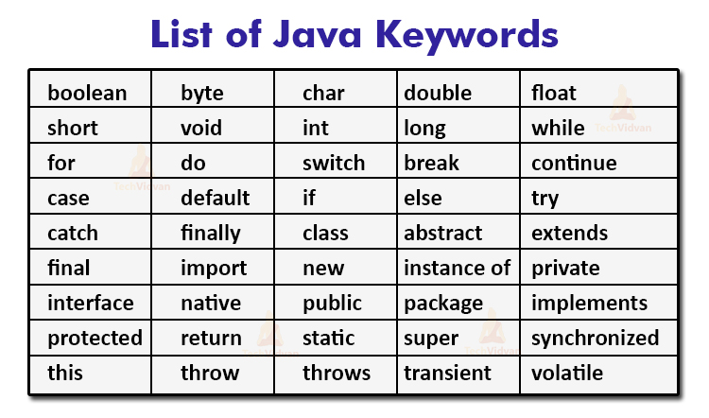
KEYWORDS Java keywords are also known as reserved words. Keywords are particular words that act as a key to a code. These are predefined words by Java so they cannot be used as a variable or object name or class name.

Slide 6
VARIABLES
A variable is the name of a reserved area allocated in memory. In other words, it is a name of the memory location. It is a combination of "vary + able" which means its value can be changed.
Types of Variables
local variable
instance variable
static variable
Reversed area
A

Slide 7
RULES FOR DEFINING VARIABLE
Names can contain letters, digits, underscores, and dollar signs
Names must begin with a letter
Names should start with a lowercase letter, and cannot contain whitespace
Names can also begin with $ and _
Names are case-sensitive ("myVar" and "myvar" are different variables)
Reserved words (like Java keywords, such as int or boolean) cannot be used as names

Slide 8
1) Local Variable
A variable declared inside the body of the method is called local variable. You can use this variable only within that method and the other methods in the class aren't even aware that the variable exists.
A local variable cannot be defined with "static" keyword.
2) Instance Variable
A variable declared inside the class but outside the body of the method, is called an instance variable. It is not declared as static.
It is called an instance variable because its value is instance-specific and is not shared among instances.
3) Static variable
A variable that is declared as static is called a static variable. It cannot be local. You can create a single copy of the static variable and share it among all the instances of the class. Memory allocation for static variables happens only once when the class is loaded in the memory.

Slide 9
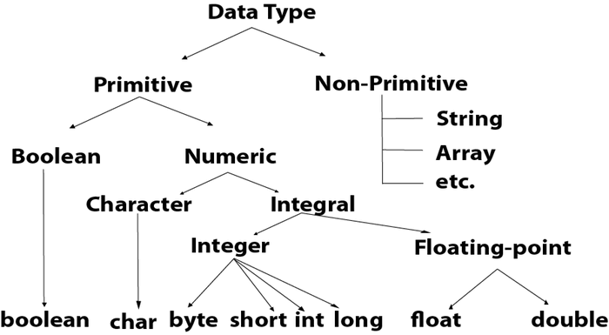
DATA TYPES
Data types specify the different sizes and values that can be stored in the variable. There are two types of data types in Java:
Primitive data types: The primitive data types include Boolean, char, byte, short, int, long, float and double.
Non-primitive data types: The non-primitive data types include Classes, Interfaces, and Arrays.

Slide 10
MEMORY ALLOCATION OF DATATYPES
Data Type | Default Value | Default size
boolean | false | 1 bit
char | '\u0000' | 2 byte
byte | 0 | 1 byte
short | 0 | 2 byte
int | 0 | 4 byte
long | 0L | 8 byte
float | 0.0f | 4 byte
double | 0.0d | 8 byte

